Slide 1
Workshop on YouTube Automation
Course : Software Development & Project Management
Instructor : Engineer Maryam Jamil
+92 332 5568674 maryam.jamil@mjaisco.com

Slide 2
Today’s Tribute
Fathers

Slide 3
About this Course
Who Can Join
Anyone Above Age of 12 Years
Who can Read and Write
Cost
Free Course in Case You will Do 3 Months Internship after Course Completion
Otherwise Student Fees : Rs. 5,000 /- Others : Rs. 8,000 /-

Slide 4
Why Software Development & Project Management Course
In today’s age of technology and digital media, staying ahead means adapting to new technologies and embracing evolving trends. This course is designed to equip you with the essential skills needed to thrive in the modern digital world.
Not only will it enhance your personal and professional brand, but it will also prepare you for real-world opportunities.
Upon completion, you'll receive: ✅ A Course Completion Certificate ✅ A 3-Month Internship ✅ An Entry-Level Job Placement

Slide 5
"Learning is the currency of the future; Spend it wisely and you’ll never be broke."

Slide 6
Software Development & Project Management Course Content
Content Writing
YouTube Automation
Sales Generation
Branding
Web Development

Slide 7
YouTube Automation
YouTube Automation is a strategy where you run a YouTube channel
Without being directly involved in content creation or appearing on camera
You outsource or automate most parts of the process

Slide 8
Guidelines for YouTube Automation
Recommended Tools:
Video Editing: Use CapCut for editing your videos efficiently.
Voiceover: Utilize ElevenLabs to generate high-quality voiceovers.
Image Generation: Create visuals using DeepAI, Canva, or Freepik.

Slide 9
Guidelines for YouTube Automation
Image Generation: Create visuals using DeepAI, Canva, or Freepik.
SCRIPT
MJais Software Consultancy
• A Software Company Venture
• Deals With
A) Websites & Web Development Apps
B) Mobile Apps Development
C) Desktop Application Development
D) Digital Marketing
E) Content Writing
F) Artificial Intelligence
G) Search Engine Optimization
H) Crypto Currency

Slide 10
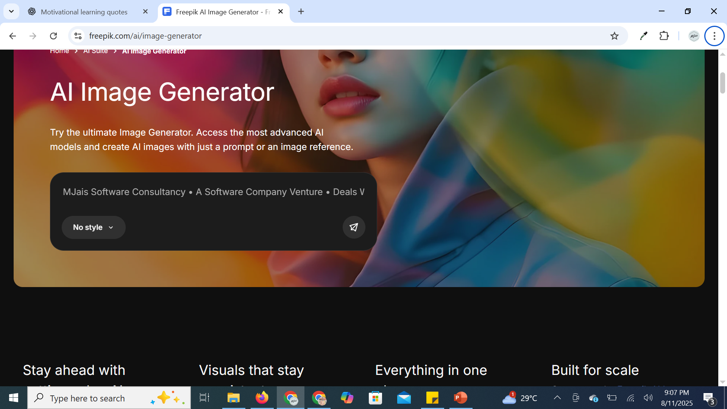
Image Generation: Create visuals using DeepAI, Canva, or Freepik.
Go to https://www.freepik.com/ai/image-generator

Slide 11
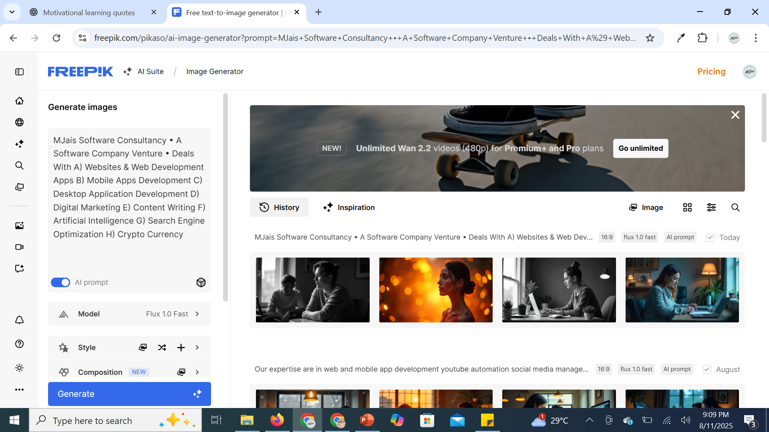
Freepik Image Generator

Slide 12


Slide 13
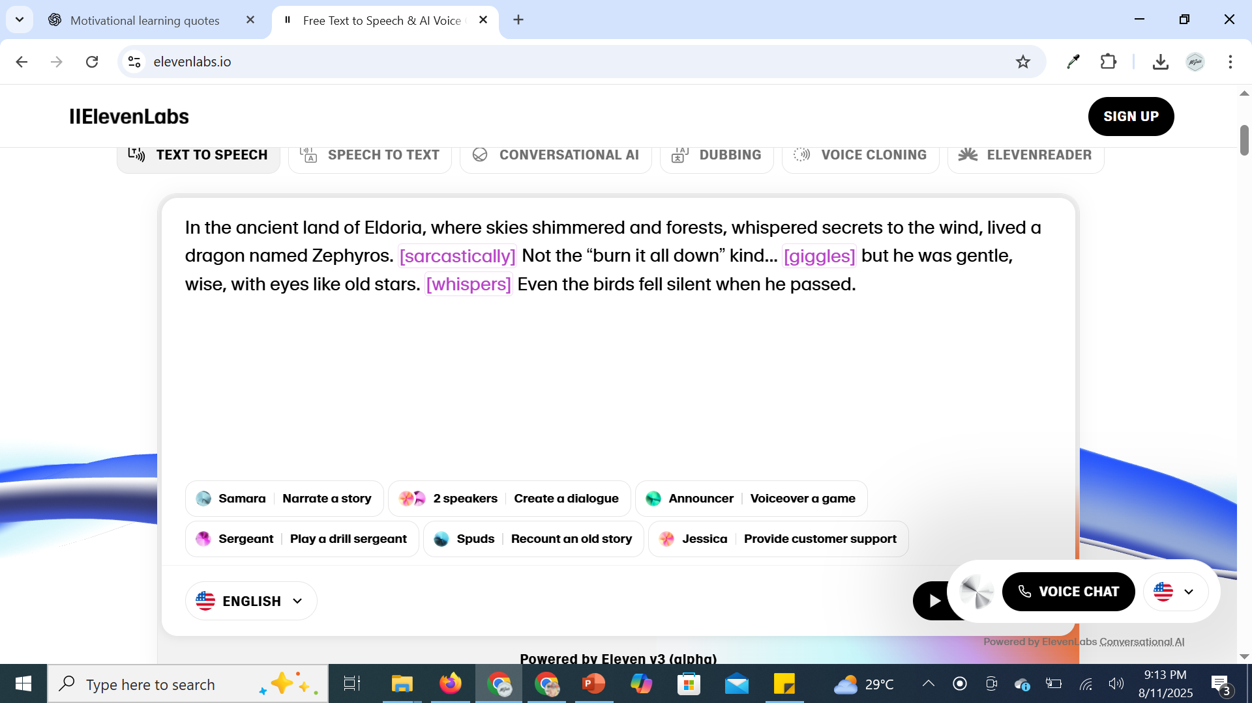
Guidelines for YouTube Automation
Voiceover: Utilize ElevenLabs to generate high-quality voiceovers.
Go to https://elevenlabs.io/

Slide 14
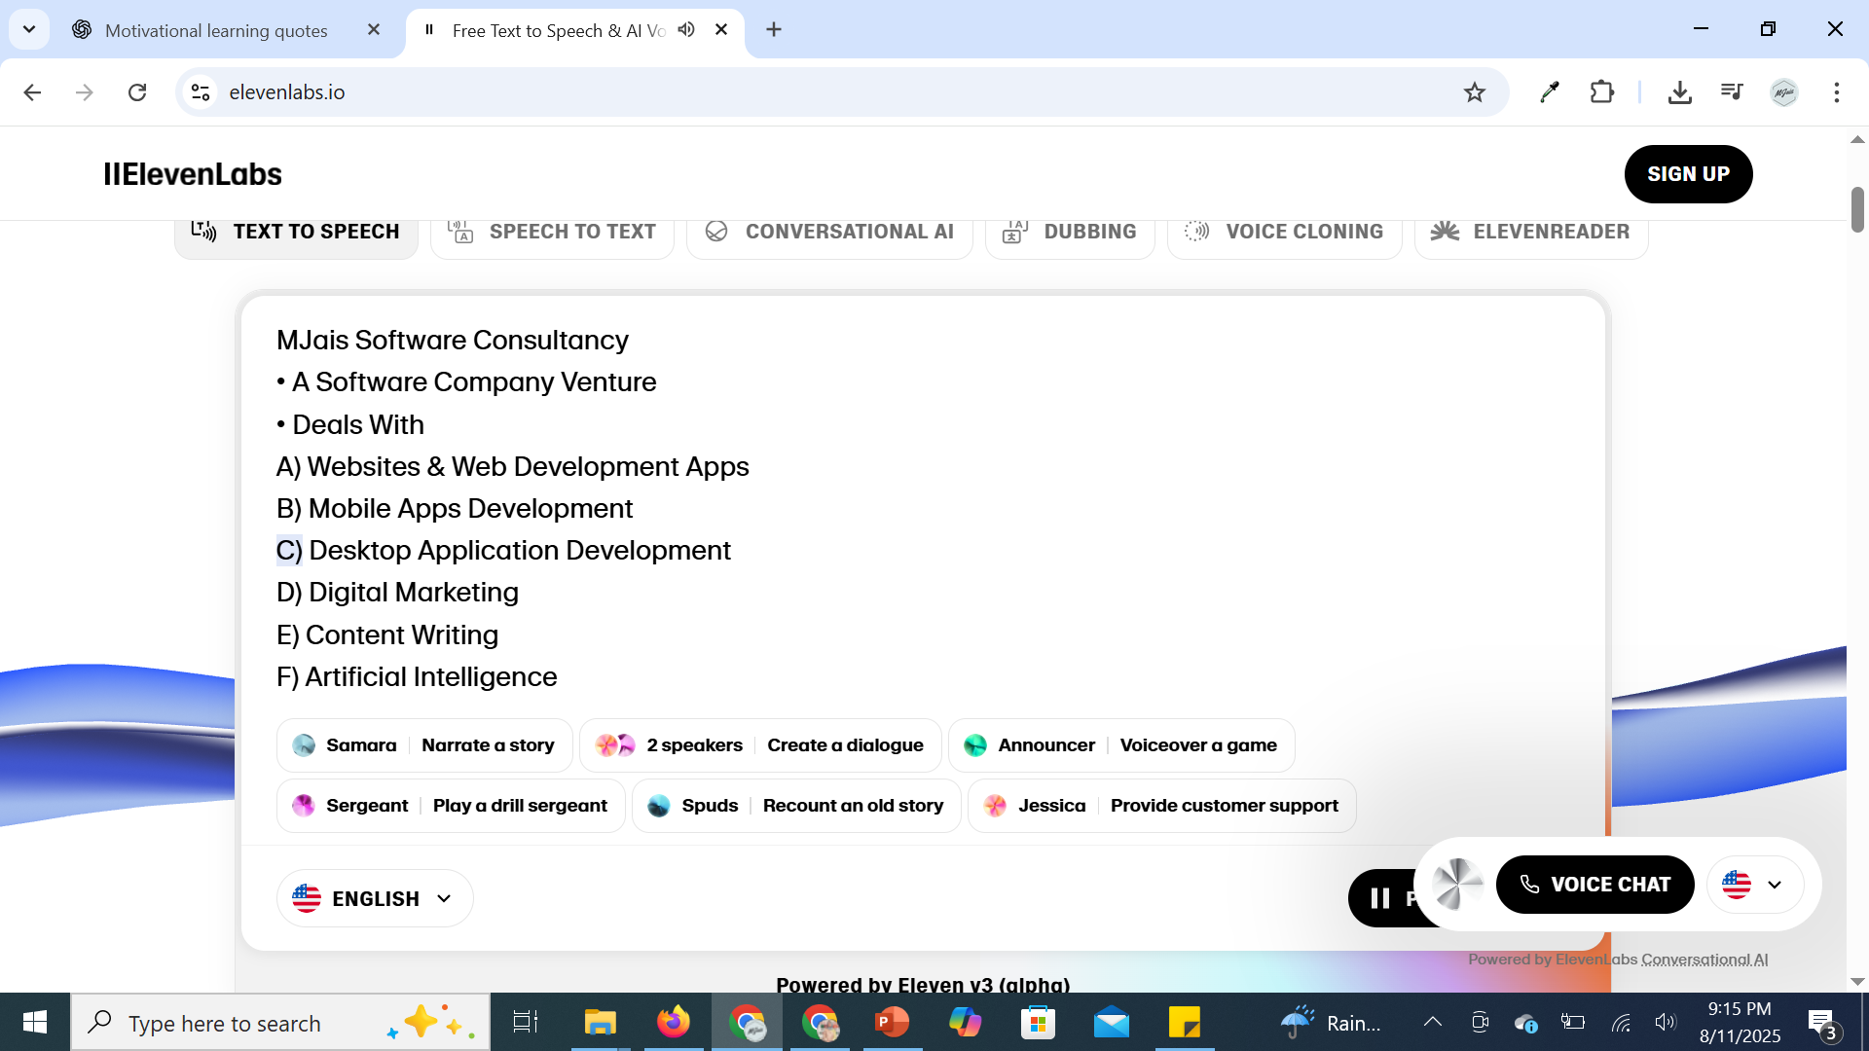
Elevenlabs Voice Generator

Slide 15
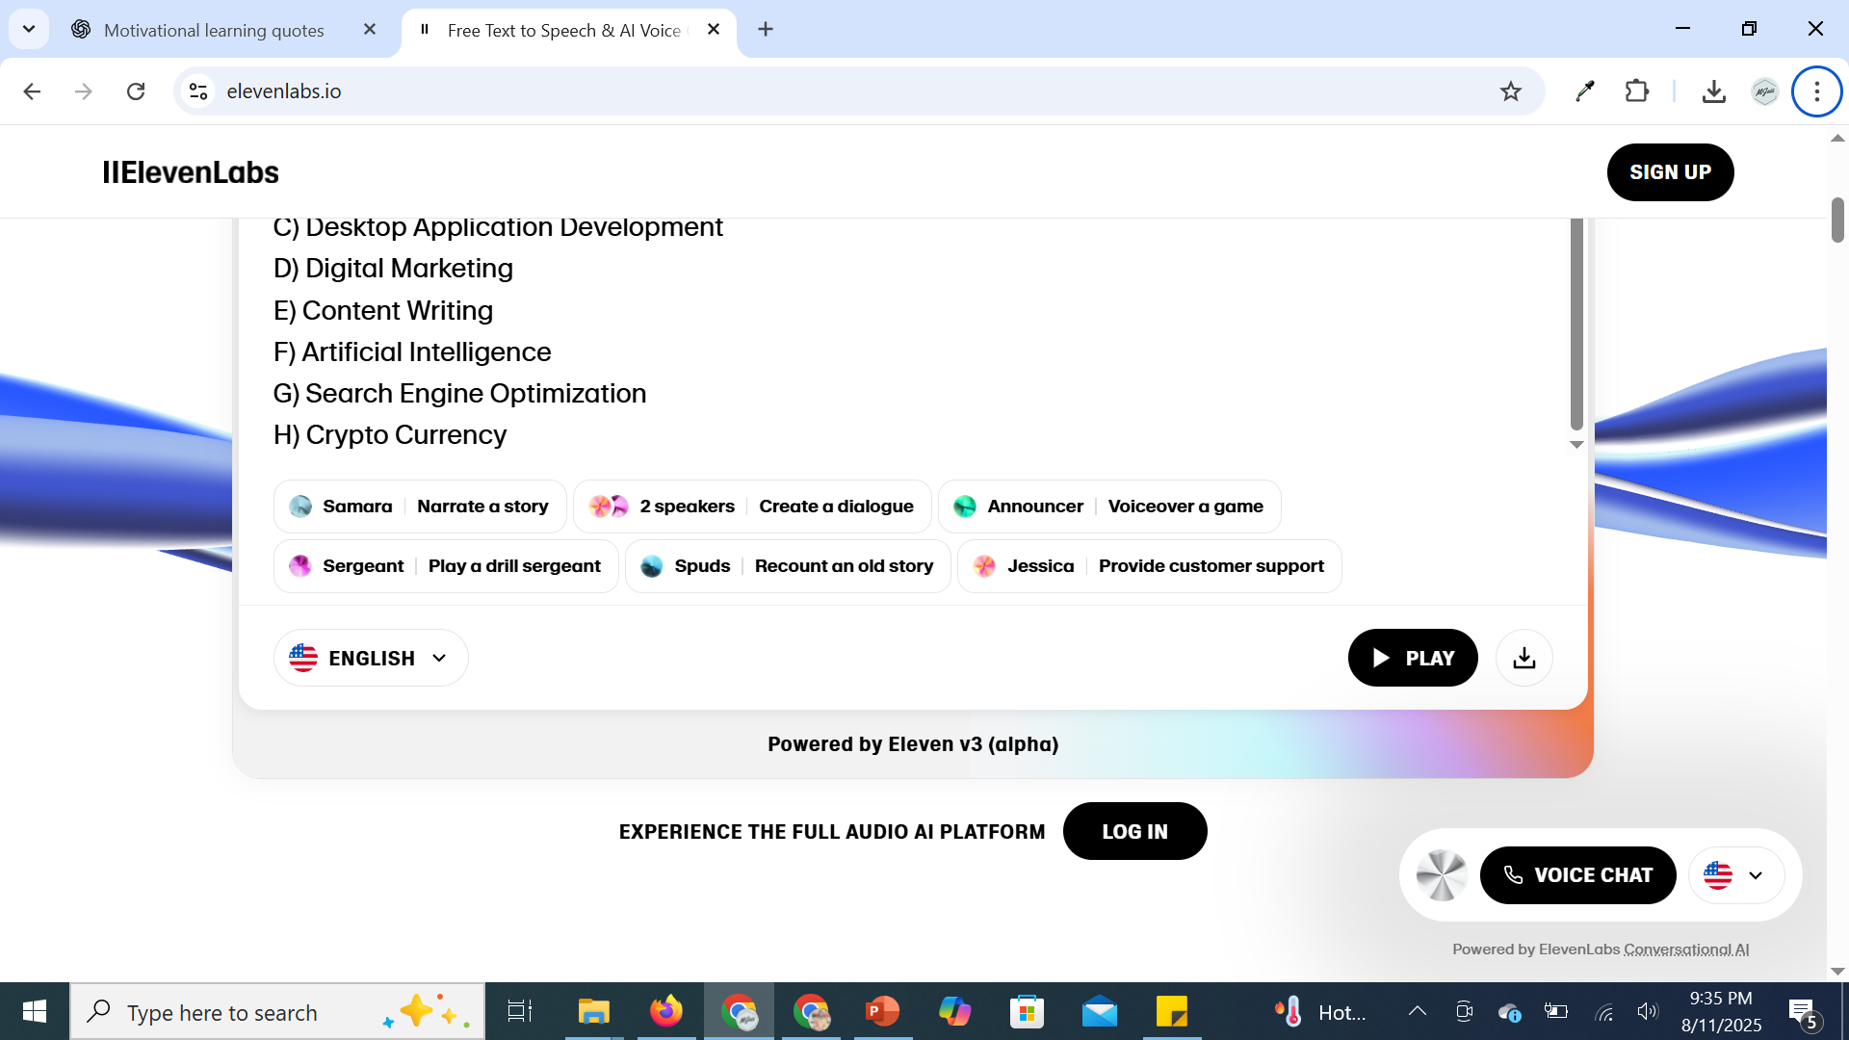
VoiceOver Generator
Videos\1AudioConvertorMJaisConsultancyElevenLabs_Text_to_Speech_audio.mp3

Slide 16
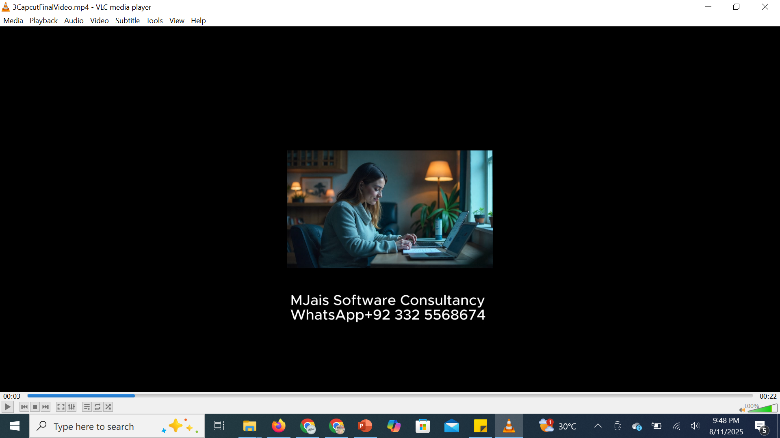
Guidelines for YouTube Automation
Video Editing: Use CapCut for editing your videos efficiently.
Videos\2CapCut _ Video Editor _ All-In-One Video Editing Software _ CapCut - Google Chrome 2025-08-09 09-16-25.mp4
Videos\3CapcutFinalVideo.mp4

Slide 17
Lecture 01 Assignment 01 YouTube Automation
Make a YouTube Shorts of Less Than 03 Minutes on These Topics
Great Muslim Leaders of ALL Time. In Case, You are Making Video on Prophet Muhammad S.A.W or His Companions, You Need To Hide their Faces.
Any Video of Your Own Interest
Upload on Google Drive & Submit it on Google Drive Link

Slide 18
Lecture 01 Assignment 01 YouTube Automation
Make a YouTube Shorts of Less Than 03 Minutes on These Topics
Services Provided by MJais Software Consultancy
Deals With
A) Websites & Web Development Apps
B) Mobile Apps Development
C) Desktop Application Development
D) Digital Marketing
E) Content Writing
F) Artificial Intelligence
G) Search Engine Optimization
H) Crypto Currency
For More Details WhatsApp +92 332 5568674 or Email Maryam.jamil@mjaisco.com
Any Video of Your Own Interest
Upload on Google Drive & Submit it on Google Drive Link

Slide 19
Guidelines for YouTube Automation
SEO Optimization – Key Areas to Learn:
Crafting effective video titles and descriptions
Using relevant video tags
Optimizing video metadata
Understanding and improving watch time
Increasing viewer engagement

Slide 20
Guidelines for YouTube Automation
SEO Optimization – Key Areas to Learn:
Crafting effective video titles and descriptions
- Use clear, concise, and keyword-rich titles to make your video discoverable.
- Place the main keyword at the beginning of the title when possible.
- Keep titles under 60 characters to avoid being cut off in search results.
- Write descriptions that are at least 250 words, naturally including keywords.
- Add timestamps and links to related content in the description.
- Always include a call-to-action (CTA) such as “Subscribe for more” or “Check out our playlist.”

Slide 21
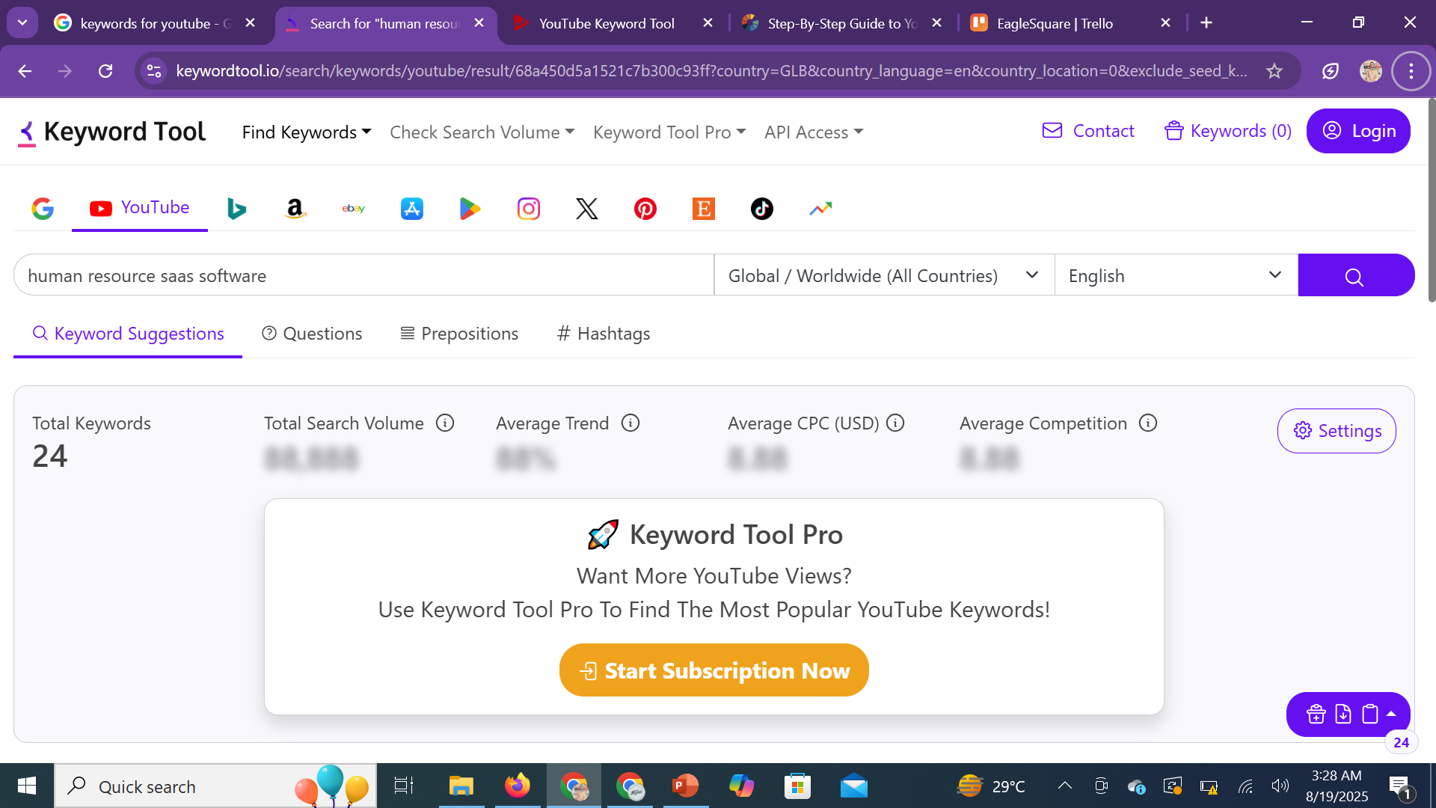
SEO Optimization – Key Areas to Learn:
https://keywordtool.io/search/keywords/youtube/

Slide 22
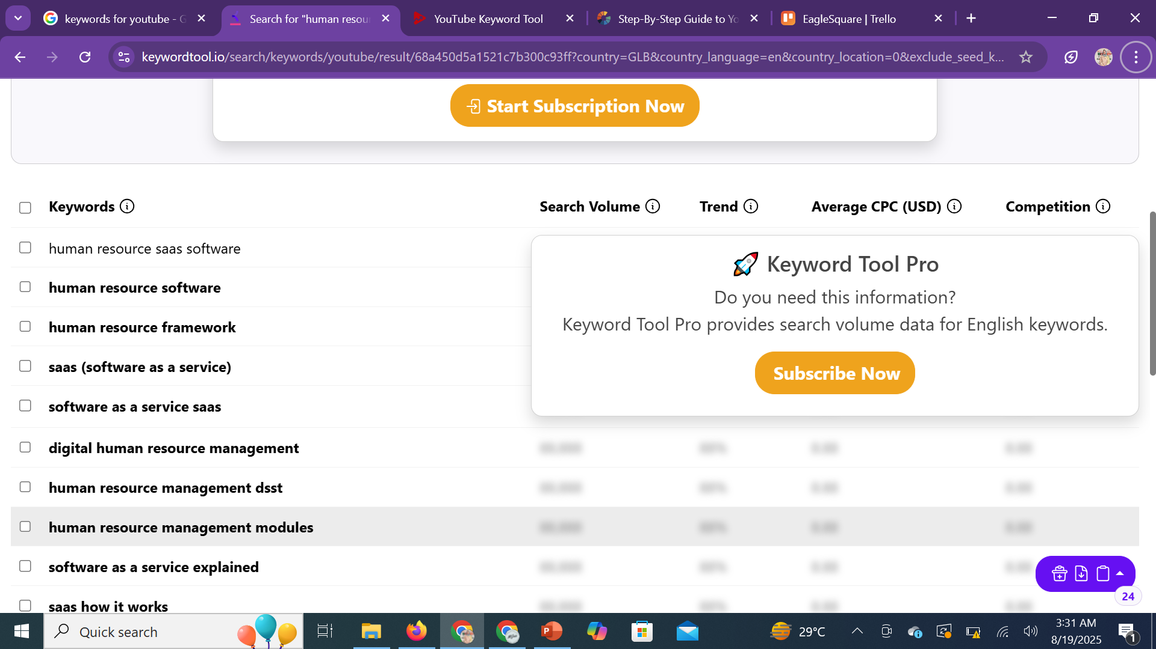
SEO Optimization – Key Areas to Learn:
KEYWORD human resource saas software Total Keywords 24

Slide 23
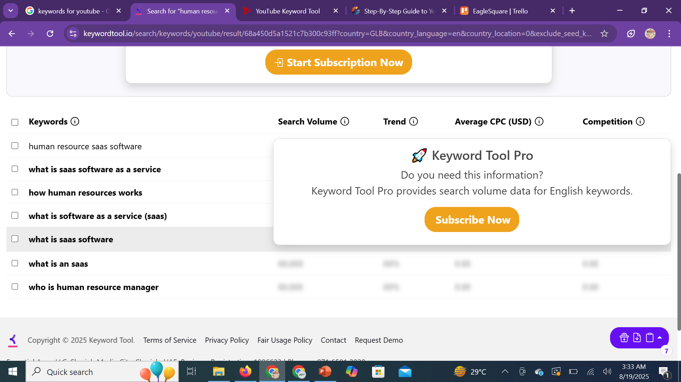
SEO Optimization – Key Areas to Learn:
KEYWORD human resource saas software Total Questions 7

Slide 24
Guidelines for YouTube Automation
SEO Optimization – Key Areas to Learn:
Using relevant video tags
- Use Your Main Keyword First Example: If your video is about YouTube SEO tips, the first tag should be "YouTube SEO".
- Include Long-Tail Keywords Add variations and phrases people might search for. Example: "YouTube SEO optimization 2025", "rank YouTube videos fast".
- Add Synonyms & Related Topics Think about how viewers describe the same idea differently.
Example: "video ranking", "YouTube algorithm tricks".
- Match Tags With Title & Description Consistency across title, description, and tags strengthens SEO signals. Use Broad + Specific Mix
Broad tag: "SEO“ Specific tag: "YouTube SEO tutorial for beginners"
- Check Competitors’ Tags Tools like TubeBuddy or VidIQ reveal which tags high-ranking videos use.

Slide 25
Guidelines for YouTube Automation
SEO Optimization – Key Areas to Learn:
Optimizing Video Metadata
Metadata is the behind-the-scenes information YouTube uses to understand your video and rank it. Properly optimizing it improves visibility.
- Title Include target keywords naturally and make it compelling.
- Description Write a keyword-rich, detailed summary (at least 250 words). Add links, CTAs, and timestamps.
- Tags Use a mix of broad and specific keywords to help YouTube categorize your content.
- Thumbnail Create a custom, eye-catching thumbnail with readable text.
- Category Choose the most relevant category to improve recommendations.
- Subtitles & Captions Add accurate captions for accessibility and better SEO.
- File Name Name your video file with keywords before uploading (e.g., youtube_seo_tips.mp4).

Slide 26
Guidelines for YouTube Automation
SEO Optimization – Key Areas to Learn:
Understanding and improving Watch Time
Watch time is one of the most important ranking factors on YouTube. It measures how long viewers actually stay on your videos and channel.
- Create Strong Hooks (First 15 Seconds Matter) Start with an engaging intro that tells viewers what they’ll get.
- Structure Content Clearly Use chapters, storytelling, or step-by-step teaching to keep viewers following along.
- Avoid Drop-Off Points Cut unnecessary pauses, filler, or long intros. Keep content tight and valuable.
- Use Playlists to Boost Session Time Group related videos in playlists so viewers continue watching.
- Encourage End-Screen & Card Clicks Add links to related videos at the end to extend viewing sessions.
- Analyze Audience Retention Graph Use YouTube Analytics to see where viewers drop off and refine future videos.

Slide 27
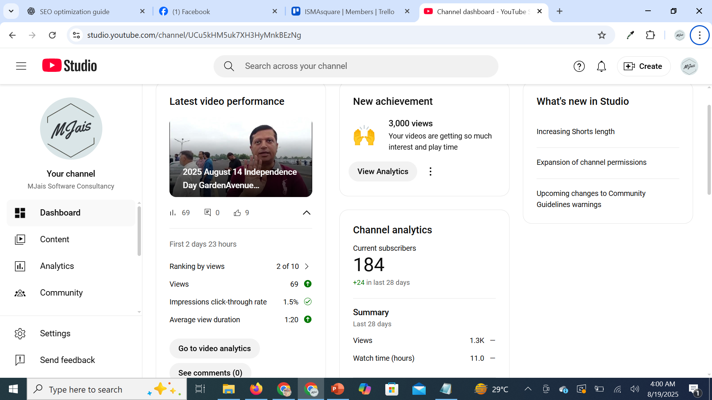
SEO Optimization – Key Areas to Learn:
Understanding and improving Watch Time

Slide 28
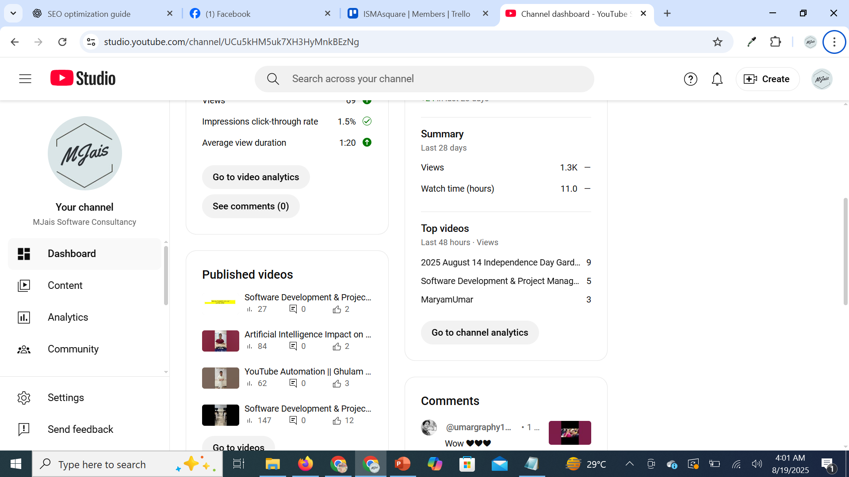
SEO Optimization – Key Areas to Learn:
Understanding and improving Watch Time

Slide 29
Guidelines for YouTube Automation
SEO Optimization – Key Areas to Learn:
Increasing viewer engagement
Viewer engagement signals to YouTube that your content is valuable, which boosts rankings and recommendations.
- Encourage Likes, Comments & Shares Add CTAs within your video: “Drop your thoughts in the comments” or “Hit like if this helped you.”
- Use Community Posts & Polls Keep your audience engaged outside of videos by using YouTube’s community tab.
- Reply to Comments Engage in meaningful conversations to build trust and loyalty.
- Create Interactive Content Ask questions, encourage challenges, or invite audience participation.
- Use End Screens & Cards Drive viewers to other videos, playlists, or your subscribe button.
- Consistency Builds Engagement Upload regularly so your audience knows when to expect new content.

Slide 30
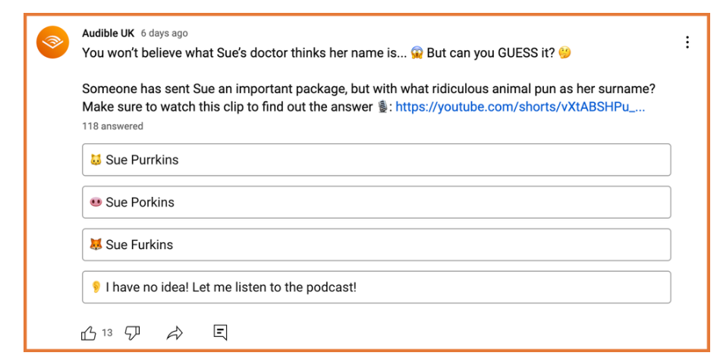
SEO Optimization – Key Areas to Learn:
Increasing viewer engagement POLLS

Slide 31
Guidelines for YouTube Automation
Steps to Achieve Better Results:
Conduct thorough YouTube keyword research
Publish high-retention videos that keep viewers watching
Set up effective YouTube video automation systems
Actively promote your videos across platforms

Slide 32
Guidelines for YouTube Automation
Steps to Achieve Better Results:
Conduct thorough YouTube keyword research
- Use YouTube’s Search Bar Start typing keywords and note the auto-suggestions. These reflect real user queries.
- Analyze Competitors Check the titles, tags, and descriptions of top-ranking videos in your niche.
- Leverage Tools for Deeper Insights Use tools like TubeBuddy, VidIQ, or Google Trends to find high-volume, low-competition keywords.
- Focus on Long-Tail Keywords Target specific phrases (e.g., “how to grow a YouTube channel fast in 2025”) instead of broad terms (“YouTube growth”).
- Check Audience Intent Ensure keywords align with what your audience actually wants to learn or watch.
- Incorporate Keywords Naturally Use them in your title, description, tags, and even spoken within your video for better indexing.

Slide 33
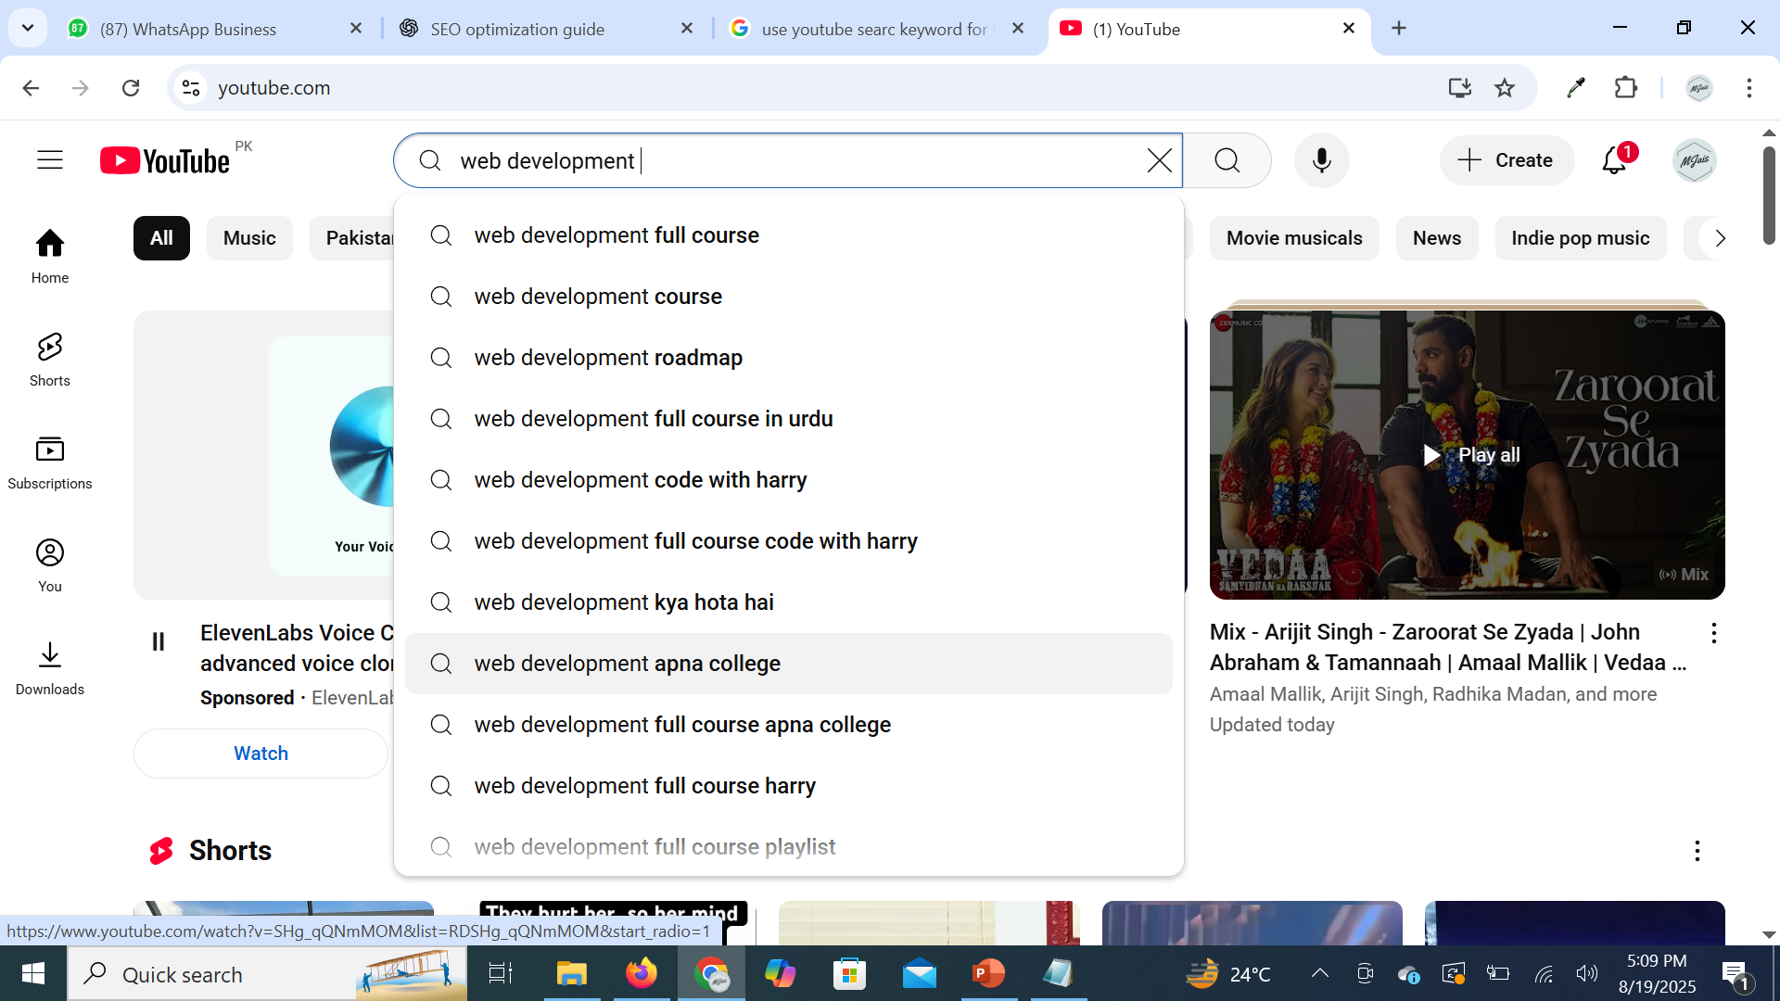
Steps to Achieve Better Results:
Use YouTube’s Search Bar

Slide 34
Guidelines for YouTube Automation
Steps to Achieve Better Results:
Publish high-retention videos that keep viewers watching
- Hook Viewers Immediately Grab attention in the first 10–15 seconds with a promise of value.
- Deliver Value Quickly Avoid long intros get straight to the point to keep viewers interested.
- Use Storytelling & Structure Organize your content into clear sections, using storytelling or tutorials that flow logically.
- Visual & Audio Engagement Use dynamic editing, graphics, captions, and background music to avoid monotony.
- Tease What’s Coming Drop hints about what’s later in the video to keep curiosity alive.
- Optimize Video Length Longer videos often rank better, but only if they maintain quality and engagement throughout.
- Analyze Audience Retention Graphs Use YouTube Analytics to identify drop-off points and improve future videos.

Slide 35
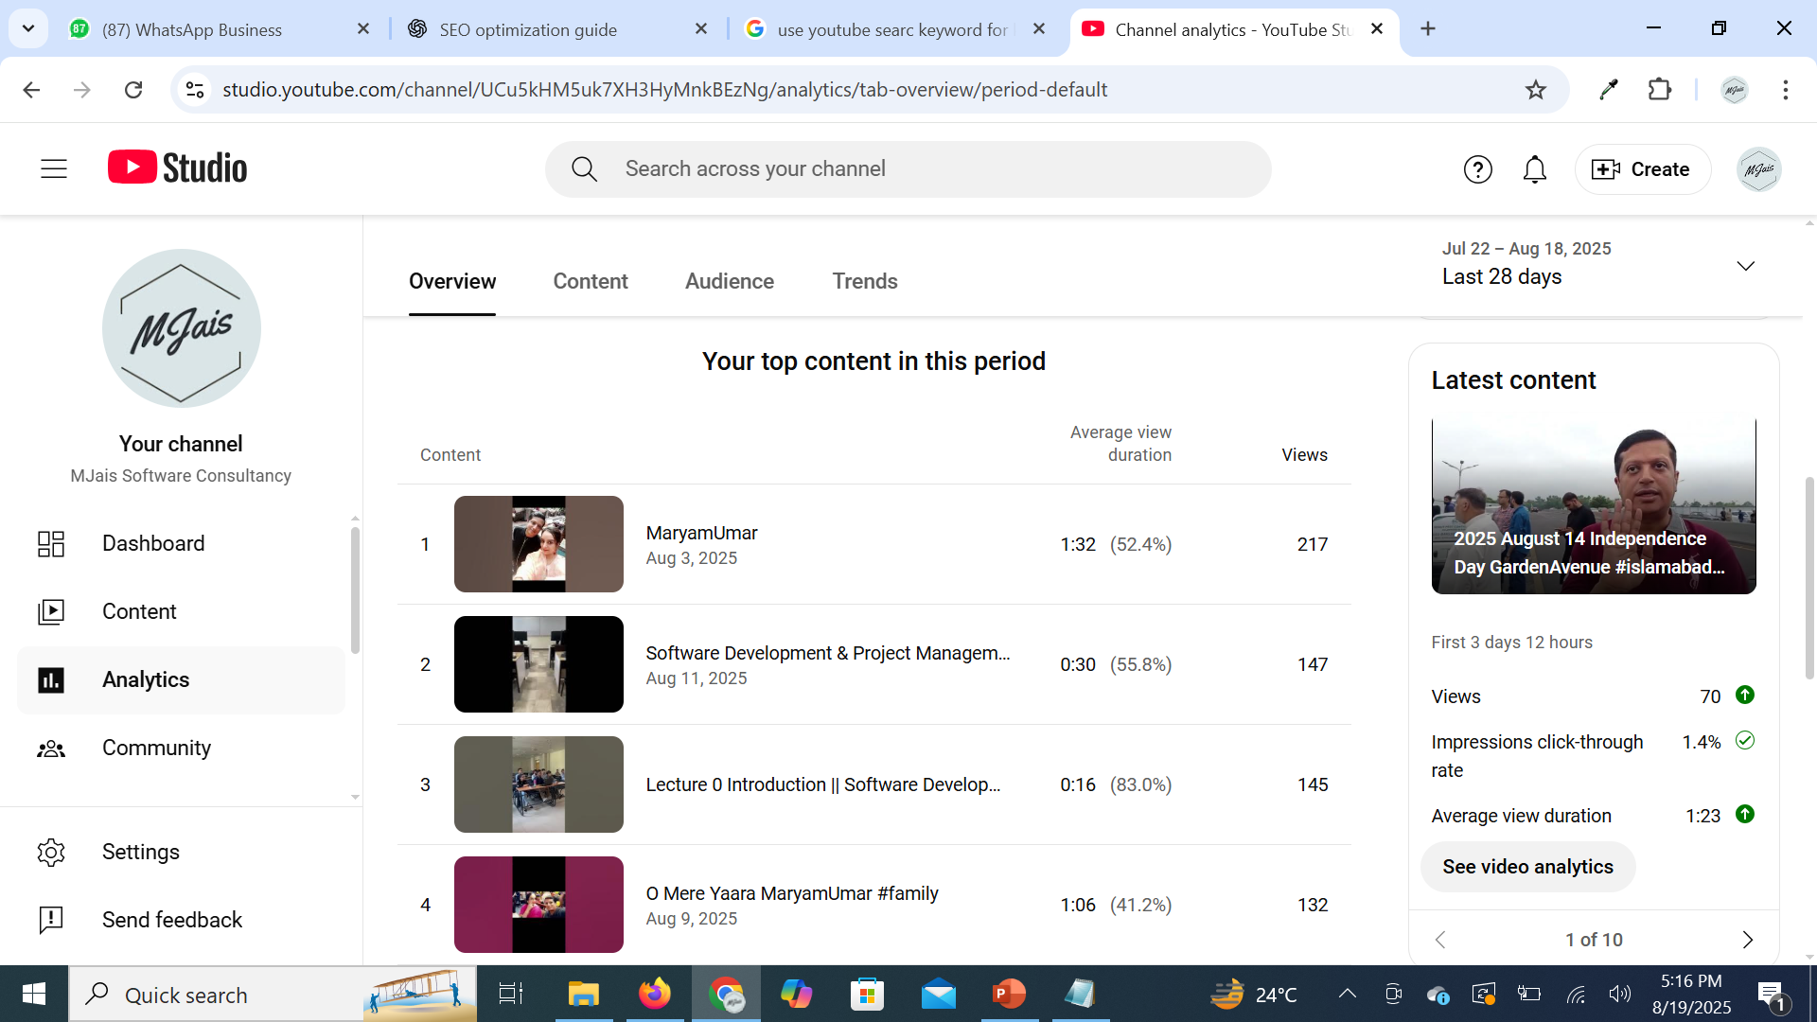
Steps to Achieve Better Results:
Analyze Audience Retention Graphs

Slide 36
Guidelines for YouTube Automation
Steps to Achieve Better Results:
Set up effective YouTube video automation systems
- Automate Upload Scheduling Use YouTube Studio to schedule uploads at peak times for your audience.
- Template-Based Descriptions & Tags Create reusable templates with links, CTAs, and keywords to save time.
- Use Playlists & Auto-Add Rules Automate adding new videos to playlists based on keywords or titles.
- Leverage Social Media Automation Use tools like Buffer, Zapier, or Hootsuite to auto-share videos across platforms.
- End Screens & Cards Automation Set default end screens/cards to direct viewers to your best content.
- Analytics & Reporting Automation Use TubeBuddy, VidIQ, or Google Data Studio to generate automated performance reports.
- Content Workflow Automation Use project management tools (Trello, Notion, Asana) with automation to streamline video production.

Slide 37
Guidelines for YouTube Automation
Steps to Achieve Better Results:
Actively promote your videos across platforms
- Leverage Social Media Channels Share videos on Facebook, Instagram, LinkedIn, TikTok, and Twitter/X with tailored captions.
- Embed Videos on Websites & Blogs Add your videos to relevant blog posts or your website for extra SEO value.
- Email Marketing Send video updates to your mailing list with catchy subject lines and thumbnails.
- Collaborations & Cross-Promotion Partner with influencers, creators, or brands in your niche to expand reach.
- Community Engagement Share in relevant groups, forums, or subreddits (without spamming) where your audience hangs out.
- Repurpose Content Convert videos into shorts, reels, or infographics to maximize reach across different platforms.
- Paid Promotion (Optional) Use YouTube Ads or boosted posts on social media to accelerate growth.

Slide 38
Lecture 01 Assignment 02 YouTube Automation
Come up with a
YouTube channel name
Design a banner and logo for it
Write the channel’s ‘About Us’ section
Create 2 YouTube Shorts scripts
1 full video script (under 5 minutes)
Any Video of Your Own Interest
Upload on Google Drive & Submit it on Google Drive Link

Slide 39


